Slide 1

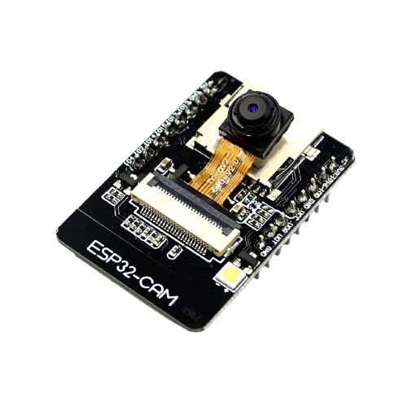

CODING
ESP32-CAM OV2640
TRAINING THE MODEL
TESTING THE MODEL

Slide 2
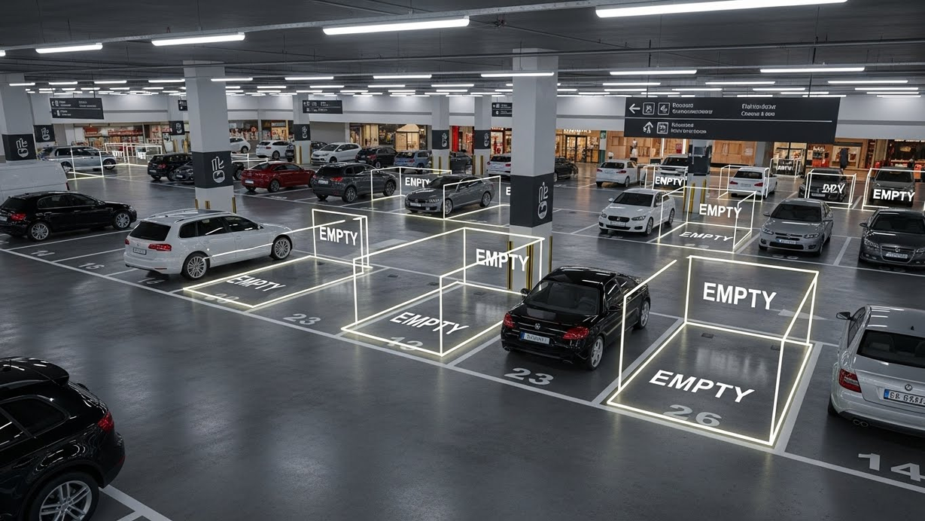
What is the aim of this Project?
This project’s aim is creating a model which is using Data Science applications to be a solution for “Finding Empty Parking Spaces”.
CODING
ESP32-CAM OV2640
TESTING THE MODEL

Slide 3
TRAINING THE MODEL
Finding Dataset
Finding the Correct Version of YOLO Model
Training YOLO Model with Dataset
Checking Correction of YOLO Model
CODING
ESP32-CAM OV2640
TESTING THE MODEL

Slide 4


TRAINING THE MODEL
Finding Dataset
Due to our project's topic, we needed to find a dataset which contains labeled, 640x640 sized, 7480 images.
We used Kaggle and Roboflow to search appropriate dataset, and found 3 datasets which satisfies our dataset criteria.
We tried to use all of 3 datasets to train our AI model; however, just one of them worked correctly. That's why, we used just one dataset to train our dataset with Fine-Tuning* method.
* Fine-Tuning: Training a model with the same dataset to further
improve its performance.
CODING
ESP32-CAM OV2640
TESTING THE MODEL

Slide 5

TRAINING THE MODEL
Finding the Correct Version of YOLO Model
YOLO is a CNN based object detection model that can be trained to detect various objects, such as parking spaces.
A CNN works remarkably like the human eye and brain. It doesn't look at the whole picture at once; it scans it piece by piece to find patterns.
First, we tried to train YOLOv8's small model to detect empty-occupied parking lots. However, this model is not consistent enough in detecting occupied and empty parking lots.
According to results, we decided to use YOLOv11's medium model, and the results are way better than YOLOv8's small model. That's why, we decided to continue with YOLOv11's medium model.
CODING
ESP32-CAM OV2640
TESTING THE MODEL

Slide 6

TRAINING THE MODEL
Training YOLO Model with Dataset
In the beginning, we tried to use Kaggle which is shown us in our Lecture to train our model. However, Kaggle's Python libraries were old; that's why, we can't train our model on Kaggle.
After that, we searched for a platform to train our model. We found Google Colab which is for training AI with Google Drive. Also, it's combined with Gemini which does things faster.
With using Google Colab, we trained our model with 100 epochs*.
* Epoch: The number of times the entire training dataset is passed
through the model.
CODING
ESP32-CAM OV2640
TESTING THE MODEL

Slide 7
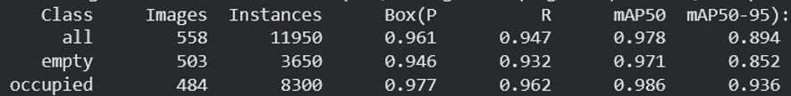
TRAINING THE MODEL
Checking Correction of YOLO Model
After training, our model's mAP50 value reached 0.978 and mAP50-95 value reached 0.894 which are good values to try this model.
mAP50 refers to the mean Average Precision calculated at an IoU* threshold of 0.50.
mAP50-95 represents the mean Average Precision averaged across IoU* thresholds from 0.50 to 0.95, providing a more comprehensive and stricter evaluation of detection performance.
CODING
ESP32-CAM OV2640
TESTING THE MODEL
* IoU: Intersection over Union

Slide 8

CODING
ESP32-CAM OV2640
Deciding to Camera Model
Coding ESP32 CAM
Getting the Live Stream
TRAINING THE MODEL
TESTING THE MODEL

Slide 9
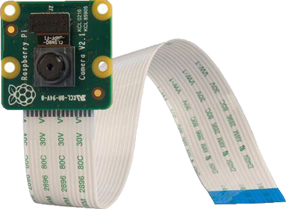
CODING
ESP32-CAM OV2640
Deciding to Camera Model
In this project, we aimed to reach real-time detection with using a camera.
To reach that, we searched for a cheap and functional camera. However, to use a camera we have code it somehow. That's why, we needed to search for a camera which also have a microcontroller to code it.
Finally, we considered about between Raspberry Pi Camera and ESP32-CAM OV2640. Although Raspberry Pi Camera is better than ESP32-CAM Ov2640, we decided to purchase ESP32-CAM OV2640 model which is cheap, and also have ESP32 microcontroller.
TRAINING THE MODEL
TESTING THE MODEL

Slide 10
CODING
ESP32-CAM OV2640
Coding ESP32 CAM
To coding ESP32-CAM OV2640 we used Arduino IDE and specific C++ libraries. However, it's not easy as it seems.
When you are programming ESP32-CAM OV2640 you should change run mode to boot mode. If it stucks on run mode, you can't load any code on microcontroller. Also, you should be careful to cable connections especially RX, TX and IO1; otherwise, you can't load any code either.
Thanks to the Indian youtubers we found the correct solutions to our problems quickly, and continued our project.
TRAINING THE MODEL
TESTING THE MODEL

Slide 11
CODING ESP32-CAM OV2640
Getting the Live Stream
As we mentioned before, we wanted to do our project real-time based.
To do this, we had to get live stream from ESP32-CAM OV2640 module.
We used some of the ESP32-CAM OV2640 libraries on Arduino IDE to get live stream, such as “esp_camera.h”, “WiFi.h”, and “esp_http_server.h”
We recognized some limitations about the live stream. First of all, if we want to get live stream, both esp32 and computer have to connect same Wi-Fi connection. Second, the range of the connection is approximately 10 meters. Finally, when ESP32-CAM moves away from computer, live stream is getting blurred and dropped.
TRAINING THE MODEL
TESTING THE MODEL

Slide 12
TESTING THE MODEL
Testing the YOLO Model on Test Images and Videos
Combining the YOLO Model and Live Stream to get Real-Time Detection
Discussion About OV2640's FPS Stability
TRAINING THE MODEL
CODING
ESP32-CAM OV2640

Slide 13
TESTING THE MODEL
Testing the YOLO Model on Test Images and Videos
In the beginning, we trained our Model with 50 epochs. When we tried it on some images which is related to our topic, the results are not enough to say the model is successful.
After these training sessions, we were not satisfied with the accuracy of the project, so we trained the model an additional 50 times to improve its accuracy.
As a result, we trained a model with a minimum accuracy of 70% and integrated this model into our real-time project.
TRAINING THE MODEL
CODING
ESP32-CAM OV2640

Slide 14
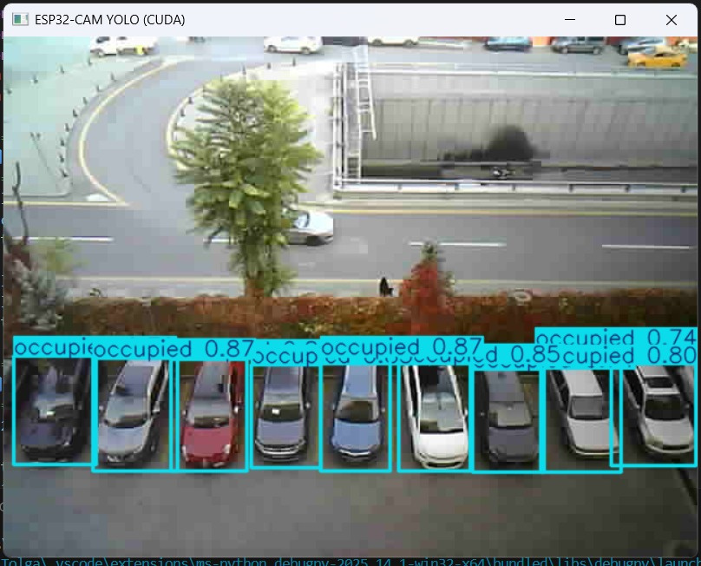
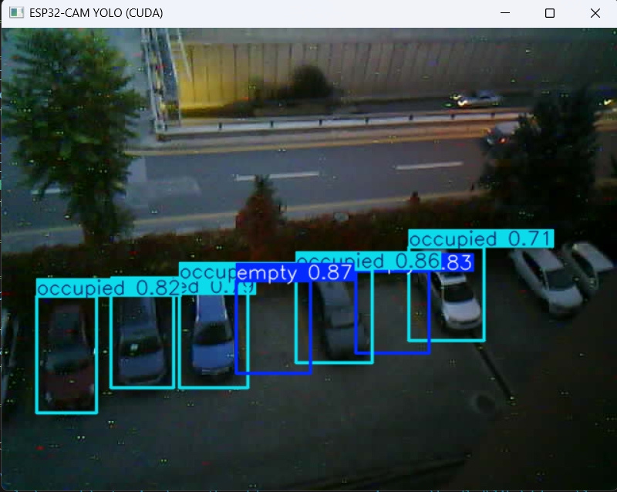
TESTING THE MODEL
Testing the YOLO Model on Test Images and Videos
TRAINING THE MODEL
CODING
ESP32-CAM OV2640

Slide 15
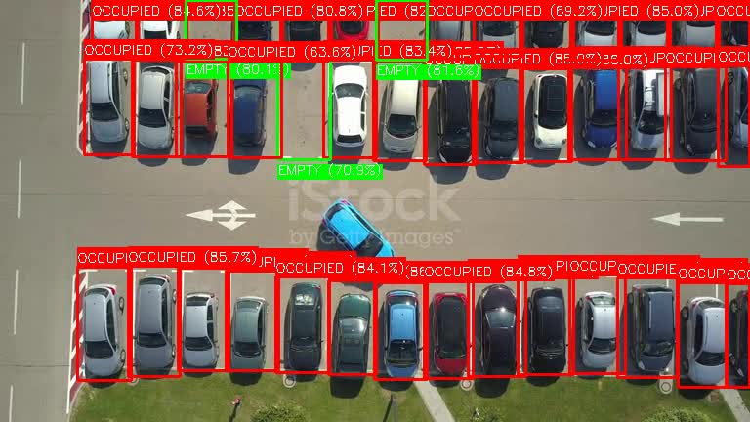
TESTING THE MODEL
Testing the YOLO Model on Test Images and Videos
TRAINING THE MODEL
CODING
ESP32-CAM OV2640

Slide 16
TESTING THE MODEL
Combining the YOLO Model and Live Stream to get Real-Time Detection
First, we retrieved the ESP32's IP address via the Arduino IDE and configured it to be the ESP32's local IP address via the router.
Then, we retrieved the video from the live stream using the URLOpen library, which was located at the IP address. We then analyzed each frame using OpenCV and Numpy.
Finally, we performed live detection on these frames using the YOLO11 model we trained on the frames using a CUDA-enabled GPU and displayed it in a separate window with OpenCV.
TRAINING THE MODEL
CODING
ESP32-CAM OV2640

Slide 17
TESTING THE MODEL
Discussion About OV2640's FPS Stability
When we tested the project in real time, we tried to maintain high image quality so that the model could easily recognise the image, but this also caused a drop in FPS.
To solve this problem, we conducted numerous trials to select the optimal range for FPS and image quality, and we achieved a result. Although it is still not as smooth as we would like, we are getting the correct result.
TRAINING THE MODEL
CODING
ESP32-CAM OV2640

Slide 18
TESTING THE MODEL
Results
This project was aimed finding empty parking spaces with using a microcontroller and data science application.
We learned training a model with using Google Colab, coding a microcontroller, and also processing a model on live-stream.
We can proudly say that we successfully completed the project and our model showed an accuracy value of 85%.
TRAINING THE MODEL
CODING
ESP32-CAM OV2640

